Slide 1
Application Monitoring
- DevOps Daemons
Kolkatta, December 2018
TCS Confidential

Slide 2
Problem Statement:
Number of DDBank.com users have increased by 17% in last 8 months. This has increased the load on system and frequent down-times; thereby delayed responses to 8% user interactions. Since the automated monitoring and tuning is not present in the system, MTTR has also increased and the IT cost has grown from $5000k year to $8000k annually.
TCS Confidential

Slide 3

I have been charged heavily for
post-production defects.
~ 10 defects * $1000
- Customer
Frequently receiving
lower Customer Satisfaction Score
- Service Provider
Have lost a travelling agency customer
because of unavailability of services for
an hour!
Lost ~ $107k annually
- Customer
Voice Of Customer
Harder to hold customer/client confidence.
The business was not sustained!
- Service Provider
I am spending too much for
4 releases per year?
500k $ per release!!!
- Customer
The customer is unlikely to recommend
our organisation further.
- Service Provider
TCS Confidential

Slide 4

As a Ops SME,
I want to receive periodic reports
on application usage,
so that I can see trends over time.
As a Ops SME/member,
I need a tool,
so that I can continuously monitor
all applications at once
in a single window.
As a Ops member,
I want to maintain configurations steps
in only one location,
so that the risk of
configuration divergence is reduced.
As a DEVELOPER,
I need feedback about my
application's impact
on Ops environment,
so I can improve its behavior over time.
User Stories:
As a Ops SME,
I want to be notified when
applications crash
or are consuming too many resources
in a production environment,
so that recovery time can be reduced.
As a DEVELOPER,
I need a way to perform
very small changes quicky,
so that I can deploy it in lesser time.
TCS Confidential

Slide 5
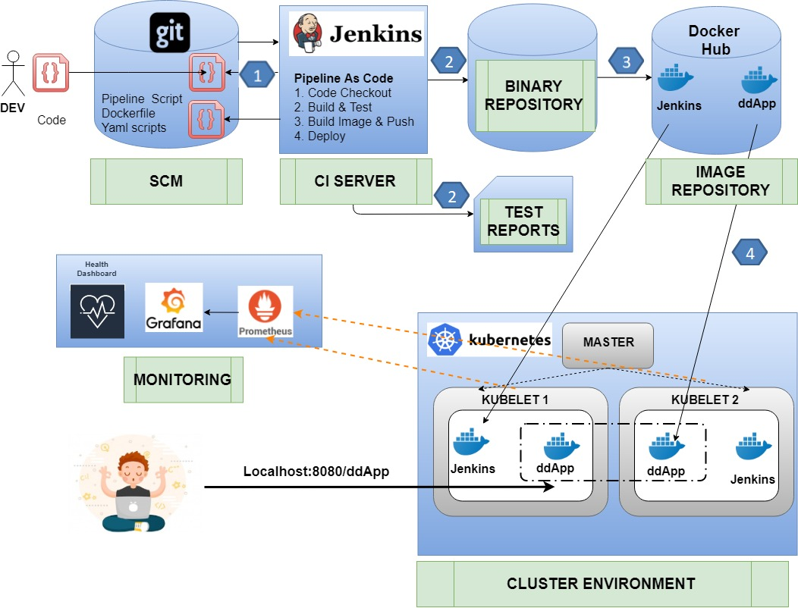
TCS Confidential

Slide 6
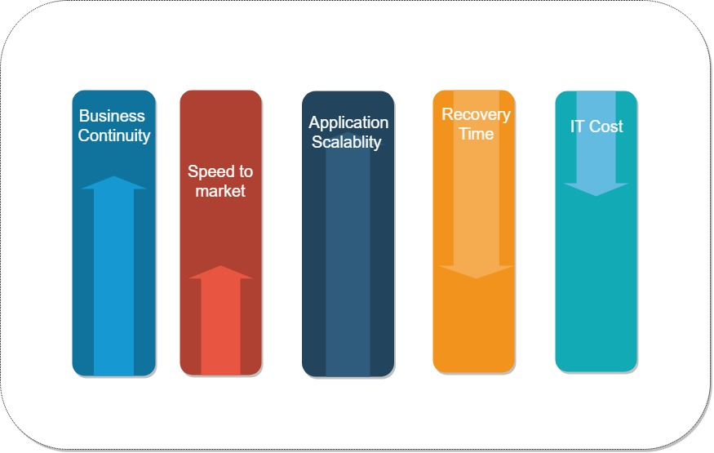
Business Benefits:
TCS Confidential

Slide 7
Grafana – Application Monitoring:
TCS Confidential

Slide 8
Grafana – Application Metrics:
TCS Confidential

Slide 9
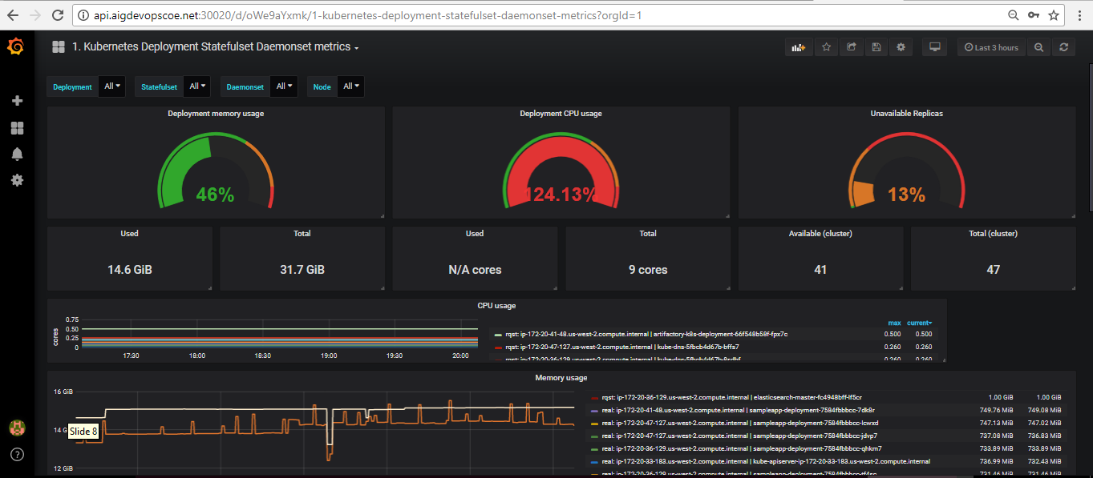
Grafana – Cluster Monitoring:
TCS Confidential

Slide 10
Thank You!
TCS Confidential

